Slide 1
Algoritma & Pemrograman
Control Flow (2)
Prepared by
Frans Panduwinata, S.Kom, M.T

Slide 2
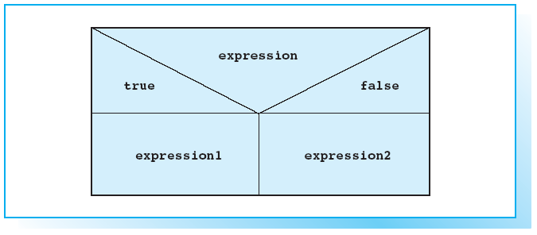
Structogram for a Conditional Expression

Slide 3
Conditional Operator
The conditional operator ?:
is used to form an expression that produces either of two values, depending on the value of some condition.
Because the value produced by such an expression depends on the value of a condition, it is called conditional expression.
A conditional expression is often a concise alternative to an if-else statement.

Slide 4
Conditional Operator (cont)
SYNTAX:
expression ? expression1 : expression2
  expression is evaluated first.
  If the result is true, expression1 is evaluated;
  if not expression2 is executed.
  The value of the conditional expression is therefore either the value of expression1 or expression2.

Slide 5
Conditional Operator (cont)
EXAMPLE:
z = (a >= 0) ? a : -a;
  This statement assigns the absolute value of a to the variable z.
  If a has a positive value of 12, the number 12 is assigned to z.
  But if a has a negative value, for example –8, the number 8 is assigned to z.
  Since this sample program stores the value of the conditional expression in the variable z, the statement is equivalent to
if( a > 0 )
z = a;
else
z = -a;

Slide 6
Precedence
The conditional operator is the only C++ operator with three operands.
Its precedence is higher than that of the comma and assignment operators but lower than all other operators. In other words, you could omit the brackets.

Slide 7
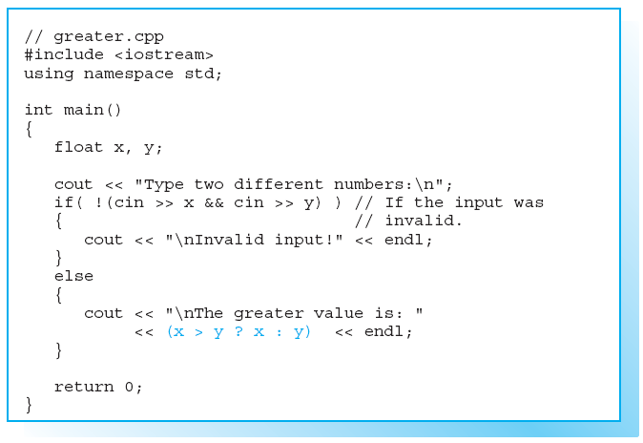
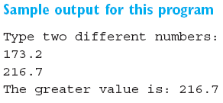
Sample Program

Slide 8
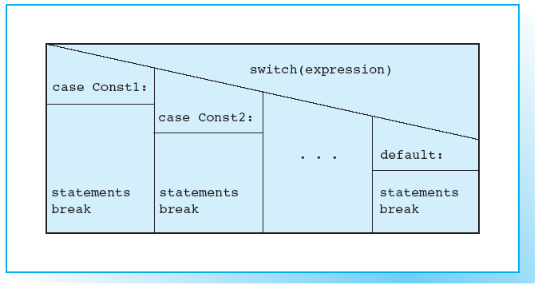
Structogram for the switch Statement

Slide 9
The switch Statement
Just like the else-if chain, the switch statement allows you to choose between multiple alternatives.
The switch statement compares the value of one expression with multiple constants.

Slide 10
The switch Statement (cont)
SYNTAX:
switch( expression )
{
case const1: [ statement ]
[ break; ]
case const2: [ statement ]
[ break; ]
.
.
.
[default: statement ]
}

Slide 11
The switch Statement (cont)
The expression in the switch statement is evaluated. It must be an integral type.
The result is then compared to the constants, const1, const2, ..., in the case labels.
The constants must be different and can only be integral types (boolean values and character constants are also integral types).

Slide 12
The switch Statement (cont)
If the value of an expression matches one of the case constants, the program branches to the appropriate case label.
You can use break to leave the switch statement unconditionally.

Slide 13
The switch Statement (cont)
If the value of the expression does not match any of the case constants,
  the program branches to the default label, if available.
  If you do not define a default label, nothing happens.
The default does not need to be the last label; it can be followed by additional case labels.

Slide 14
Differences between switch and else-if Chains
The else-if chain is more versatile than the switch statement.
Every selection can be programmed using an else-if chain. But you will frequently need to compare the value of an integral expression with a series of possible values.
A switch statement is more easily read than an equivalent else-if chain, so use the switch statement whenever possible.

Slide 15
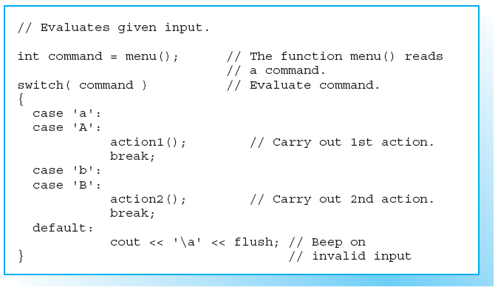
Example

Slide 16
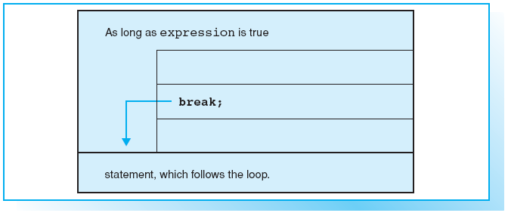
Structogram for break within a while statement

Slide 17
break
The break statement exits from a switch or loop immediately.
You can use the break keyword to jump to the first statement that follows the switch or loop.

Slide 18
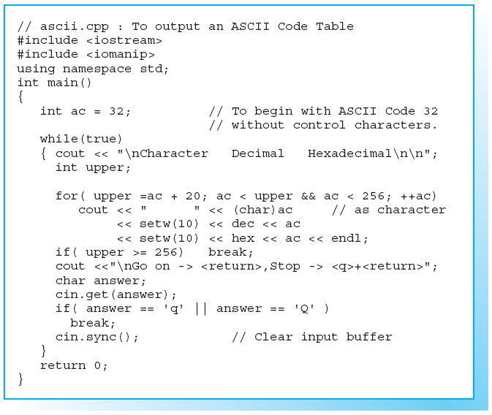
Sample Program Containing a break Statement (1)

Slide 19
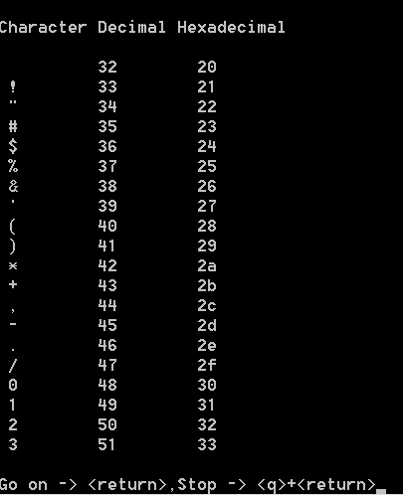
Sample Program Containing a break Statement (2)
Screen Output:

Slide 20
continue
The continue statement can be used in loops and has the opposite effect to break, that is, the next loop is begun immediately.
In the case of a while or do-while loop the program jumps to the test expression, whereas a for loop is reinitialized.

Slide 21
continue (cont)
EXAMPLE:
for( int i = 0; i < 100; i++ )
{
. . . // Processes all integers.
if( i % 2 == 1)
continue;
. . . // Process even numbers only.
}

Slide 22
goto and Labels
goto statement and labels allows you to jump to any given point marked by a label within a function.
For example, you can exit from a deeply embedded loop construction immediately.
EXAMPLE:
for( . . . )
for( . . . )
if (error) goto errorcheck;
. . .
errorcheck: . . . // Error handling
A label is a name followed by a colon. Labels can precede any statement.

Slide 23
goto and Labels (cont)
goto statement can lead to “spaghetti code”
Spaghetti code is a term for source code that has a complex and tangled control structure, especially one using many GOTO statements
EXAMPLE:
10 i = 0
20 i = i + 1
30 PRINT i; " squared = "; i * i
40 IF i >= 10 THEN GOTO 60
50 GOTO 20
60 PRINT "Program Completed."
70 END

Slide 24
goto and Labels (cont)
Structured programming style EXAMPLE:
10 FOR i = 1 TO 10
20 PRINT i; " squared = "; i * i
30 NEXT i
40 PRINT "Program Completed."
50 END
In Real-world, occurrences of spaghetti code are more complex and can add greatly to a program's maintenance costs.

Slide 25
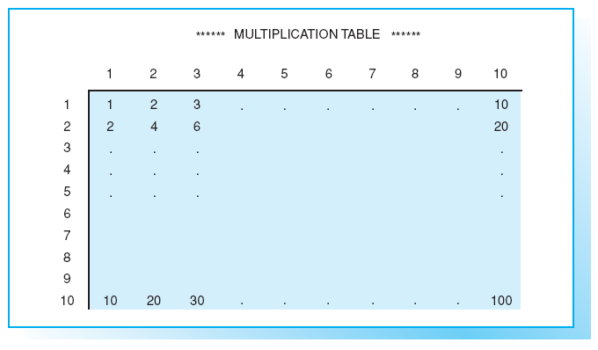
Exercises
EXERCISE 1
Write a C++ program that outputs a complete multiplication table (as
shown below) on screen.

Slide 26
Exercises (cont)
EXERCISE 2
Write a C++ program that reads an integer between 0 and 65535 from
the keyboard and uses it to seed a random number generator. Then
output 20 random numbers between 1 and 100 on screen.
NOTE:
#include <stdlib.h> // Prototypes of srand() and rand()
cin >> seed; // Reads an integer.
srand( seed); // Seeds the random number generator.
(rand() % 100 + 1) // Random number between 1 and 100

Slide 27
Exercises (cont)
EXERCISE 3
Write a program for the following numerical game:
  The computer stores a random number between 1 and 15 and the player(user) attempts to guess it.
  The player has a total of three attempts.
  After each wrong guess, the computer tells the user if the number was too high or too low.
  If the third attempt is also wrong, the number is output on screen.
  The player wins if he or she can guess the number within three attempts.
  The player is allowed to repeat the game as often as he or she wants.

Slide 28
Exercises (cont)
EXERCISE 3 (cont)
NOTE:
Use the function time() to initialize the random number generator:
  #include <time.h> // Prototype of time()
  #include <stdlib.h> // Prototypes of srand() and rand()
  long sec;
  time( &sec ); // Take the number of seconds and
  srand( (unsigned)sec ); // use it to initialize.

